Slide 1


SOFA Fashion Social Network
SOFA Team – Spring 2021
Hanoi, May 7th , 2021

Slide 2

Phạm Ngọc Hà
Supervisor

Slide 3
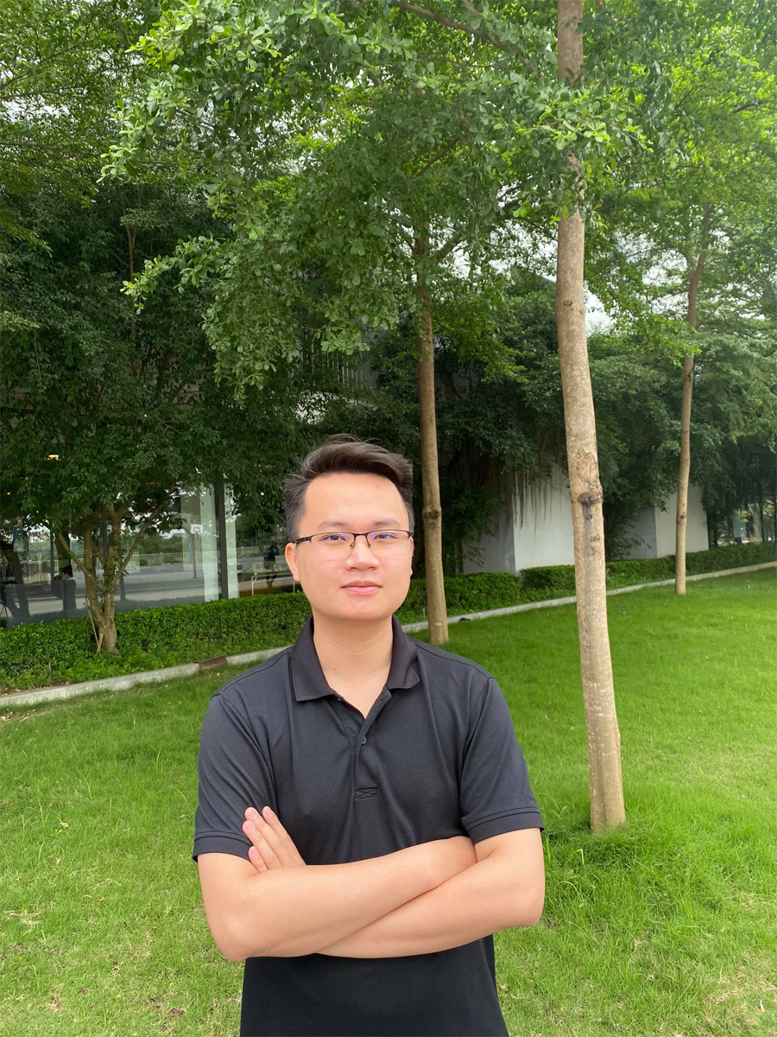

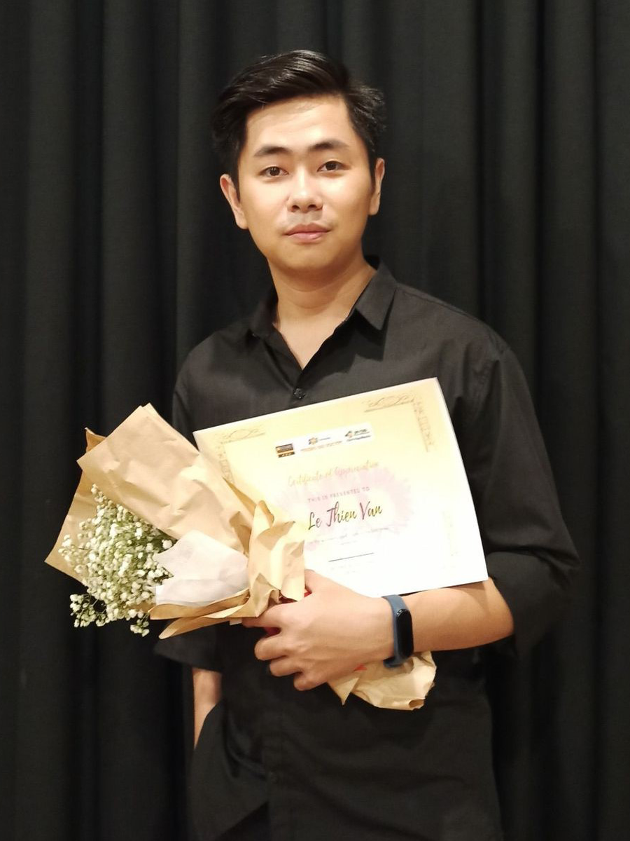
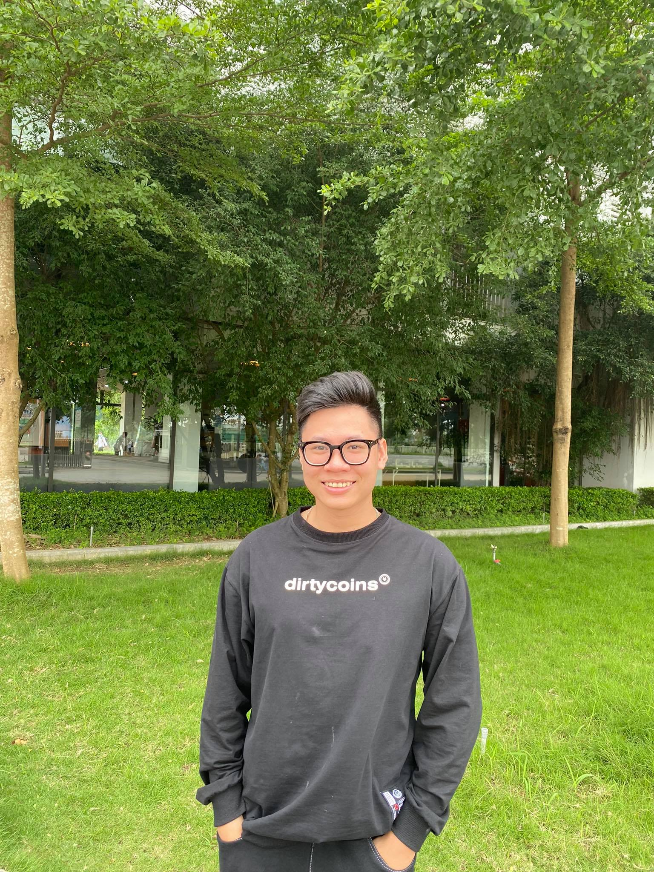

SoFa
Nguyễn Thanh Tùng
Team
Nguyễn Huy Hoàng
Lê Thiện Văn
Hà Việt Dũng
Mai Văn Viên
Team member
Team member
Team leader
Team member
Team member

Slide 4

Agenda
Introduction
03.
01.
02.
Software Requirement Specification
Project management plan
Software Design
Testing
04.
05.
Demo – Q & A
06.

Slide 5

01.
Introduction

Slide 6

Goals
PROJECT INFORMATION
BACKGROUND
EXISTING SYSTEMS
PROPOSAL SYSTEM
Project name, team members
Reasons make us came up with this idea
Review of existing systems
System function, work flows, tool and techniques

Slide 7
Project information
Project name: SOFA – Fashion Social Network Project code: SOFA Project group name: SOFA Team Product type: Web and Mobile application
Timeline: From 4th January 2021 to 28th April 2021

Slide 8
Background

Slide 9
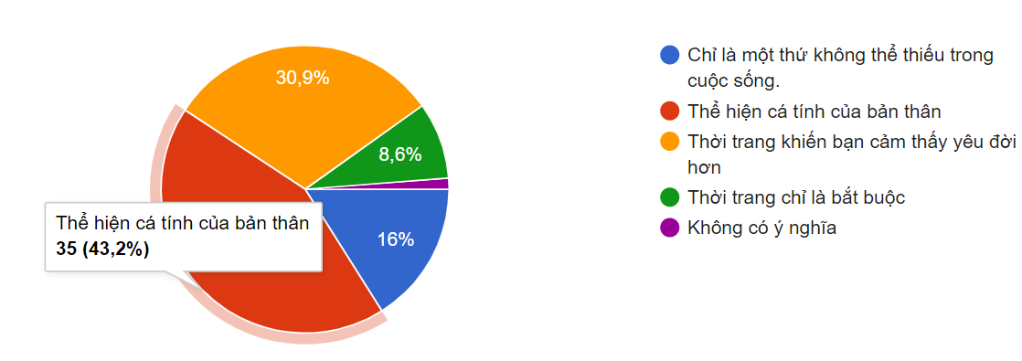
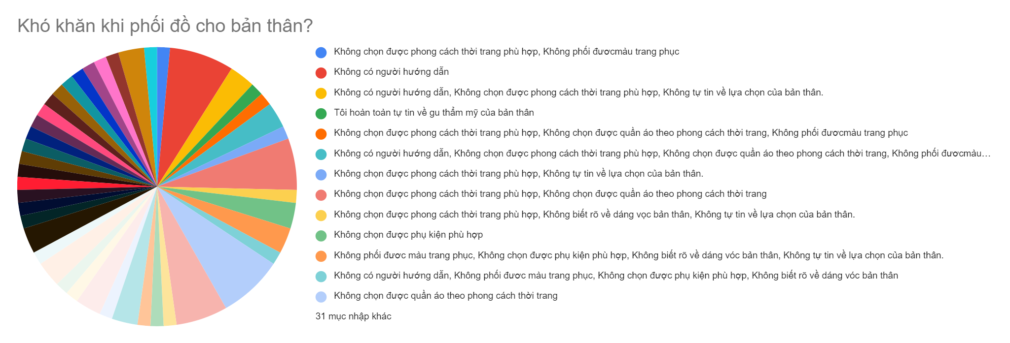
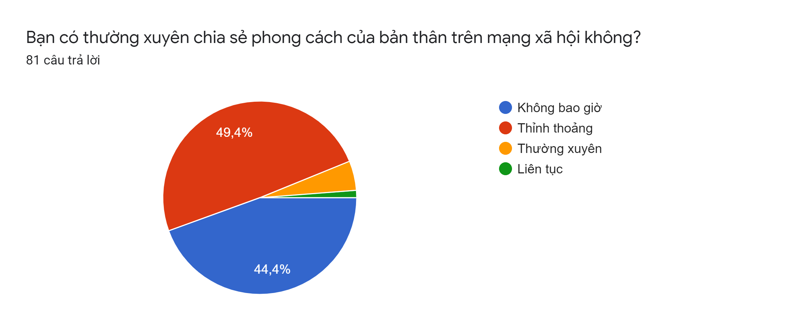
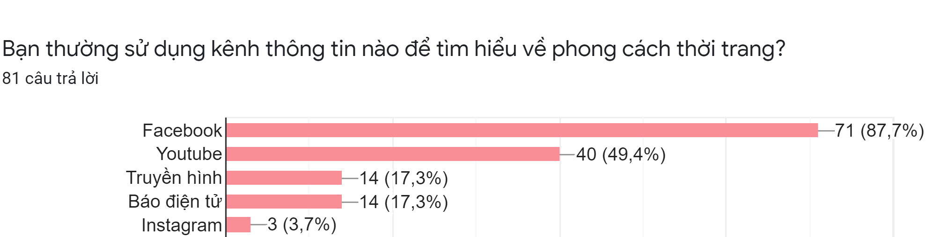

Slide 14


Background
Facebook
Youtube

Slide 15

Proposal System
Build a social network for everybody. Help users share their fashion style and find suitable style for themselves.

Slide 16
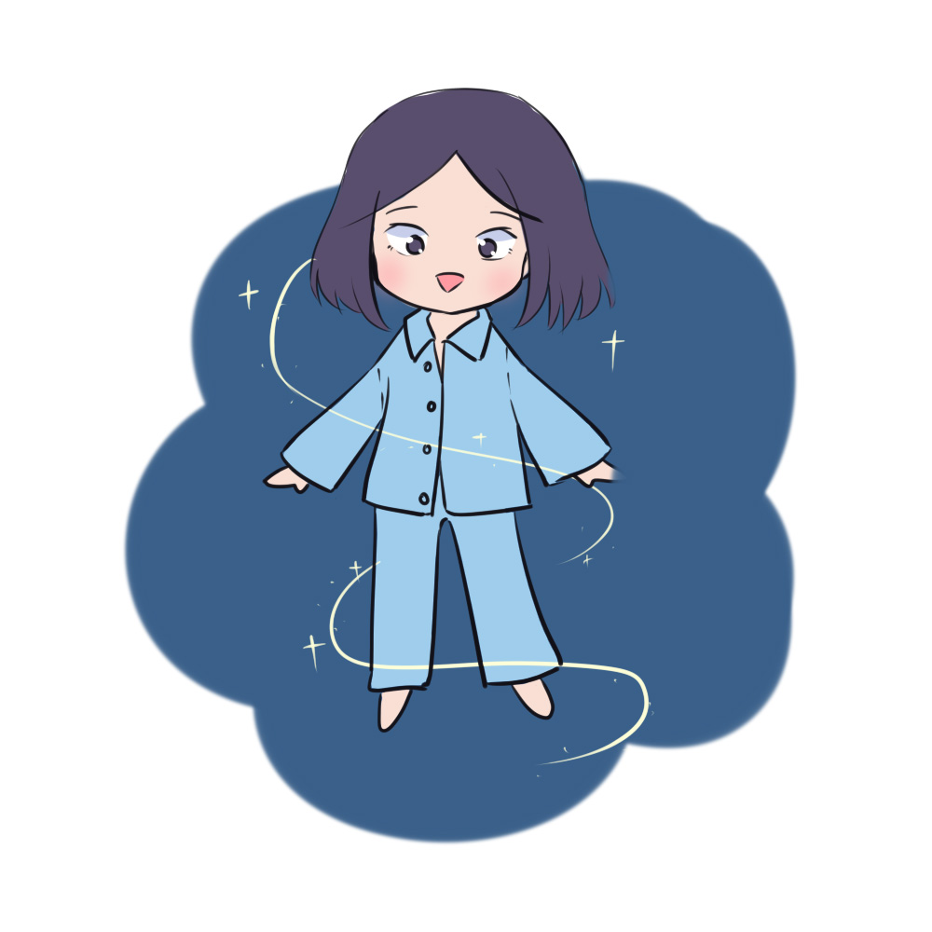
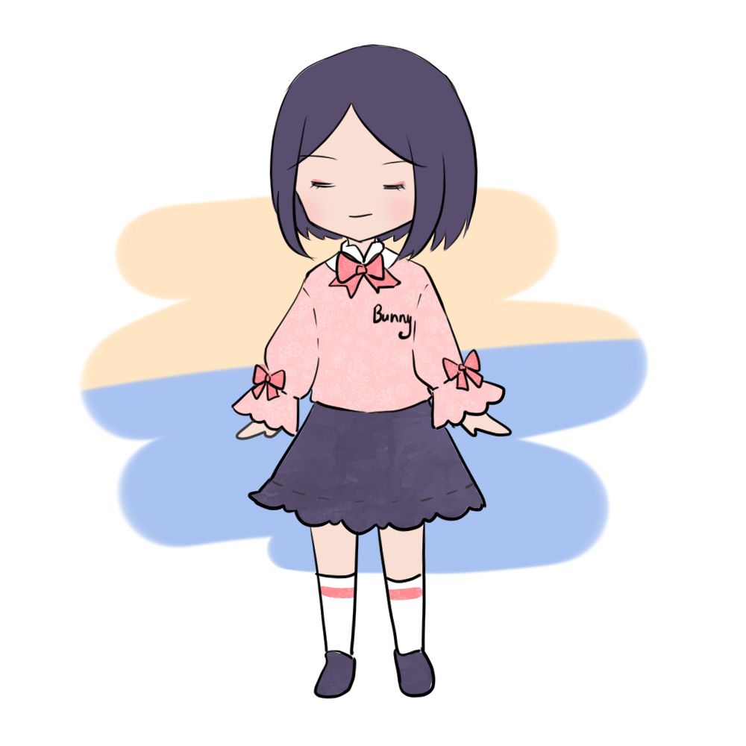
ROLE
User
System Manager
Users who use client app
Manager who use manager page

Slide 17
SYSTEM FUNCTION
View newsfeed (public article, hot article, recommend article)
React article (like, rate, comment, report)
Modify article (update, delete)
User interact (follow, report)
Chat with friend
Search sell place by image
Find suitable fashion
Manage balance and voucher
Manage notification
Search article or user by keyword
User
System Manager

Slide 18
SYSTEM FUNCTION
Manage user
Manage article
Manage report
Manage feedback
Manage support request
Manage voucher
Manage balance
Manage system statistics
User
System Manager

Slide 19
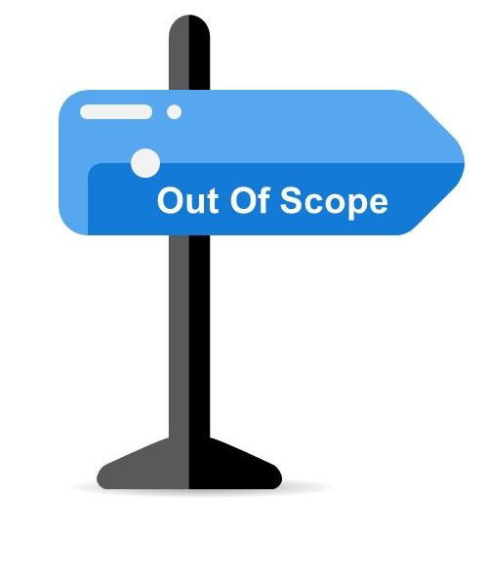
OUT OF SCOPE FUNCTION
Hide post, unhide post
Share post
Block user
Call voice & call video
Delete comment
Multiple languages
Product advertisement
Privacy setting

Slide 20
Category | Tools and techniques
Programming languages & runtime | C#, Python, Html, Css, JavaScript, TypeScript
Frameworks | ASP.Net core API, Angular 8, React Native
Software architecture | MVC
API | Clarifai, ZaloPay
Operating system | Windows 10, window server 2012
Deployment server | IIS Server (Server machine)
Version control | GitHub, Git 2.27.0
IDE/Editors | Visual Studio 2017
UML tools | Draw.io, Lucid chart, Microsoft office visio
DBMS | SQL Server Management System 2017
Project management tools | Trello
Process model | Agile Software Process Model
Communication tools | Facebook, Skype, google meet
Files management tools | Google Drive

Slide 21

02.
Project management plan

Slide 22
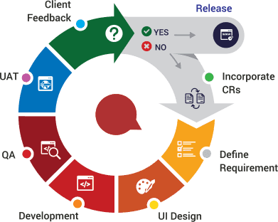
Software Process Model
Agile process model

Slide 23

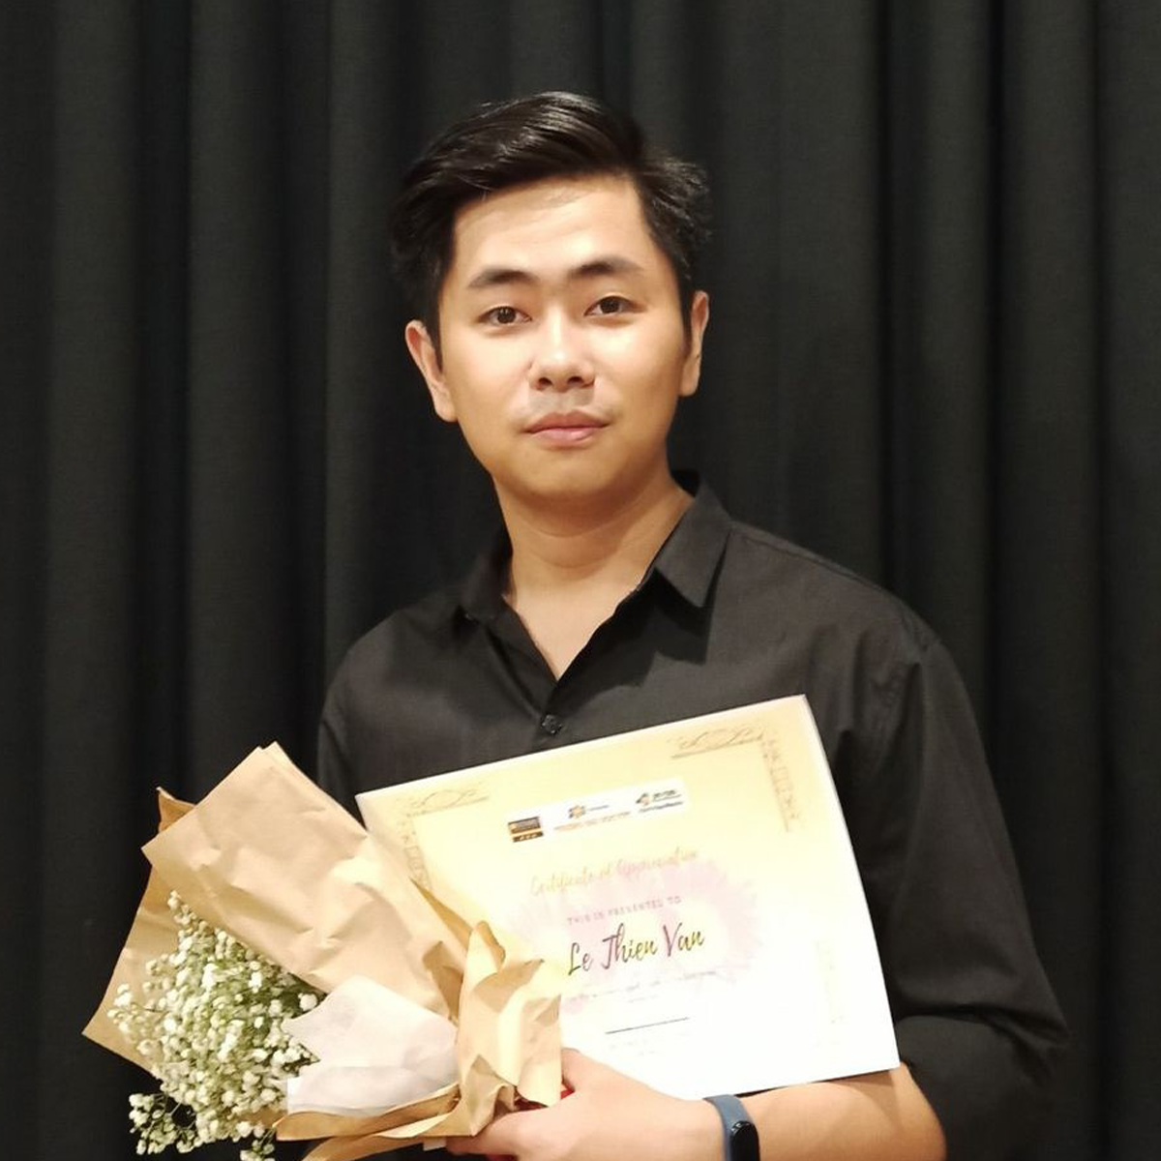

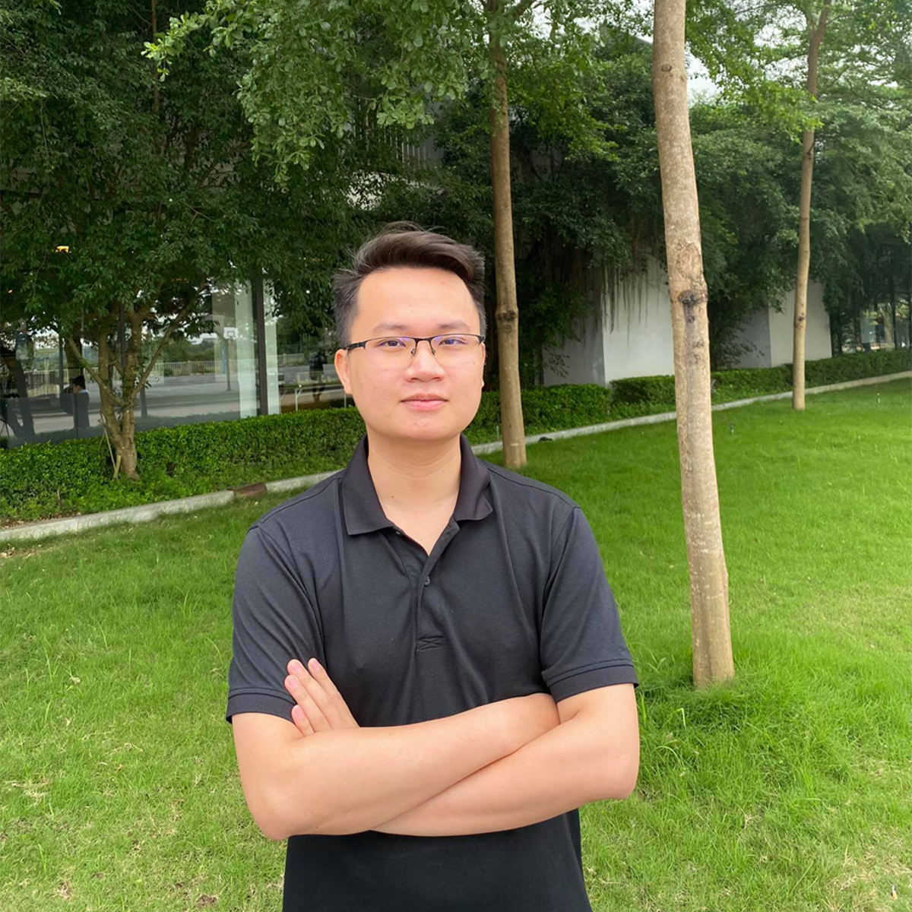
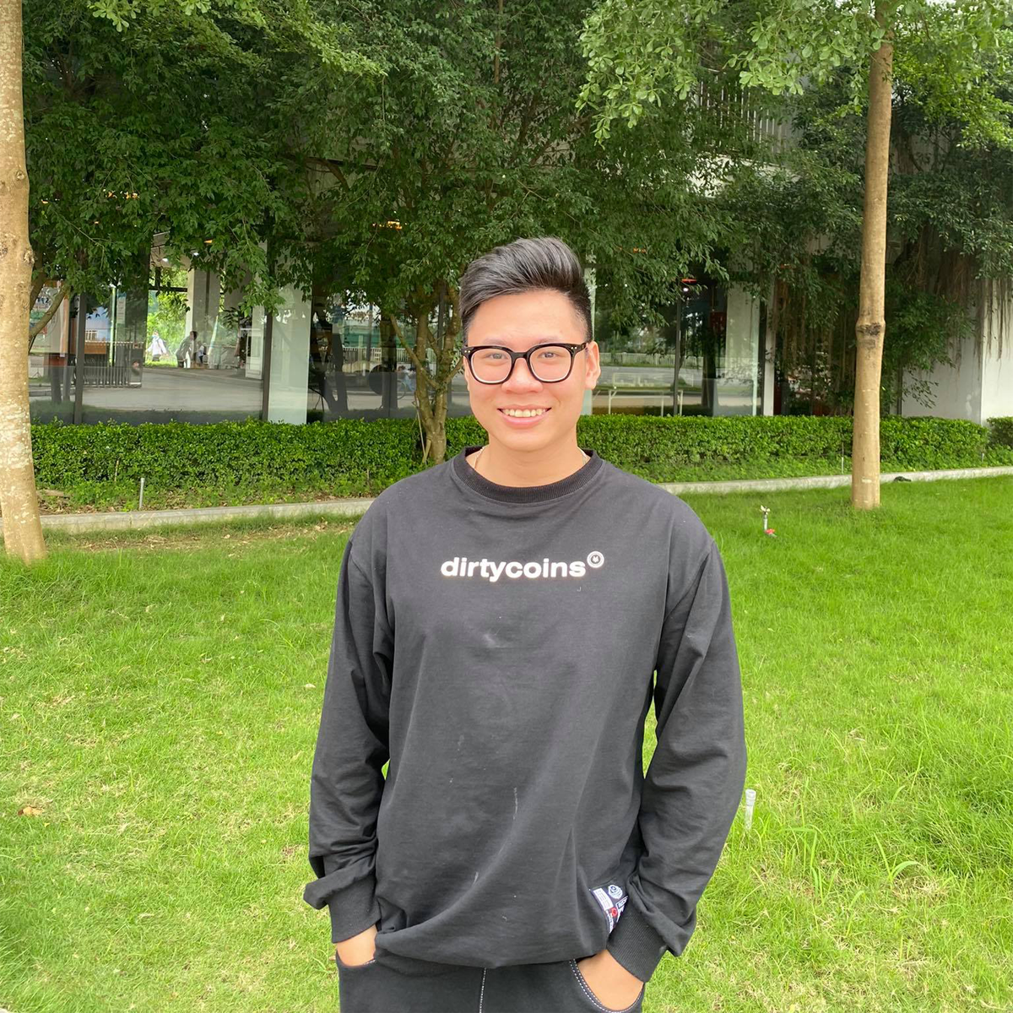

Phạm Ngọc Hà
Supervisor
Lê Thiện Văn
Project Manager
Nguyễn Huy Hoàng
Developer
Nguyễn Thanh Tùng
Developer
Hà Việt Dũng
Developer
Mai Văn Viên
Developer

Slide 24
Roles and Reponsibilities
Member | Detail Responsibilities
Lê Thiện Văn | Project Manager, technical leader, developer
Nguyễn Huy Hoàng | Analysis leader, developer, tester
Mai Văn Viên | Test Leader, developer, analysis member
Hà Việt Dũng | Designer, developer, tester
Nguyễn Thanh Tùng | Quality Assurance Manager, developer, analysis member

Slide 25



Teamwork
Meeting supervisor: once a week
Team meeting: once a week
Location: Room R107 / R313, Alpha Building, FPT University
Communication:

Slide 26
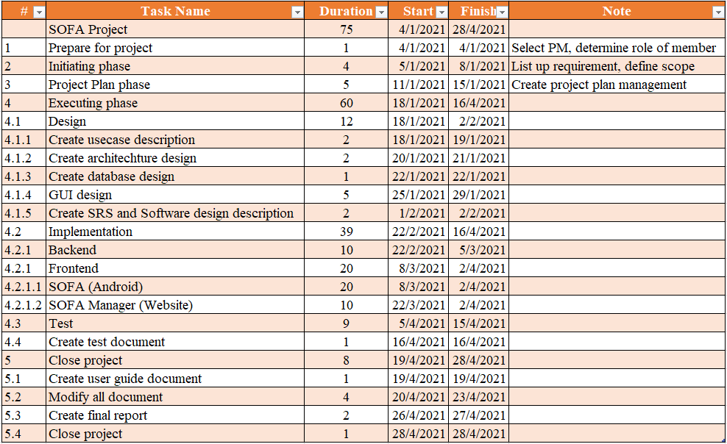
Prject Plan

Slide 27
Risk management plan
# | Risk | Description | Impact | Possibility | Response Plans
1 | Inaccurate Estimations | Schedule is inaccurate | Medium | Medium | 1) Create schedule carefully 2) Add backup time (or backup schedule) 3) Focus on close targets
2 | Poor Quality Code | The code may be difficult to read, meaning it is difficult for other developers to review or make changes | High | Low | 1) Code reviews 2) Clear coding standards and guides 3) Testing of all code
3 | Inadequate Human Resources | Don't have enough member to complete project be on time | Medium | Low | 1) Register overtime for team member
4 | Technical Difficulties | Have issues during coding | Medium | Medium | 1) Choose design pattern appropriate 2) Create architecture design more detail and exactly 3) Have a professional in team
5 | Security | The system is unsafe for user, hacker can attack and take user information… | High | High | 1) Using token for improving backend security 2) Add more algorithm for hash private information 3) Take preventive measures hacking
6 | Serious error in synchronization between web and mobile platform | display on browser and mobile is more difference. Maybe, the component just can use on web but not mobile | Medium | High | 1) Choose another component to fix 2) Make components difference but similar feature
7 | lack of requirement | Developer create code was not enough requirement | High | Medium | 1) Code reviews 2) Clear coding standards and guides 3) Testing of all code

